Slide 1

PROCESS AUTOMATION
AGILE SOFTWARE DEVELOPMENT
TEAM:
SUPRIYA MURTY
ASHU KAPIL
PRATEEK TUTEJA
SIDHARTH NUNIA

Slide 2
ROLES and RESPONSIBILITIES
Supriya Murty: Developer - Developing excel macros, writing code and creating reports
Prateek Tuteja: Business Analyst: Solution design, developed visualization, support development and testing
Sidharth Nunia: Product Owner: Creating product backlog, estimation and prioritization of tasks
Ashu Kapil : Scrum master - Marketing strategy, Scheduling meetings, removing roadblocks and ensuring progress

Slide 3
PROBLEM STATEMENT
Part 1
Automating the process of Monthly financial reporting for Airbnb as per the data provided
Part 2
Creating a Consolidated file to automate the current process for better maintenance. Creating dynamic reports and dashboards for stakeholders and investors
Part 3
Devising a framework to market Palms Place villa to big corporation for events in Vegas

Slide 4
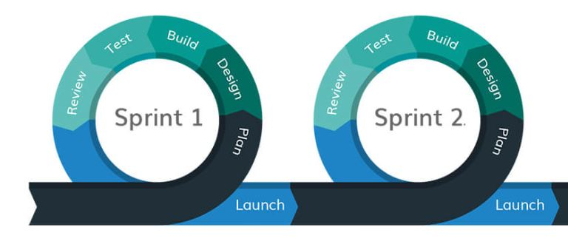
PROCESS
Adopted Agile methodology.
Implemented the tasks in the form sprints (2 weeks)
Initiated the project with Sprint Planning.
Organized Daily Standups to track the progress.

Slide 5
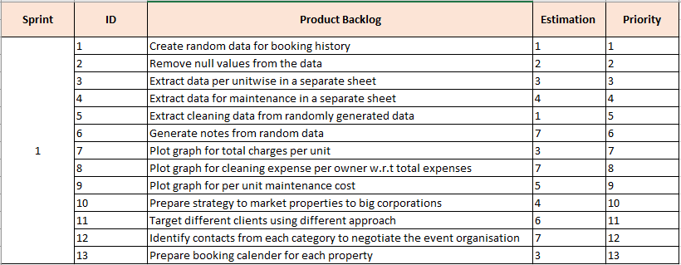
Product Backlog

Slide 6
KEY FINDINGS
For Part 1:
Airbnb data pulled manually from the website contained many unwanted and unnecessary data and required data cleaning and data validation before reporting it to the investors or stakeholders
Automated the process and found out an easy way to perform data reporting using excel macros;
Final Report generated shows that most amount earned by the investor is in the month of January.
The total amount earned by the investor was $11723.184

Slide 7
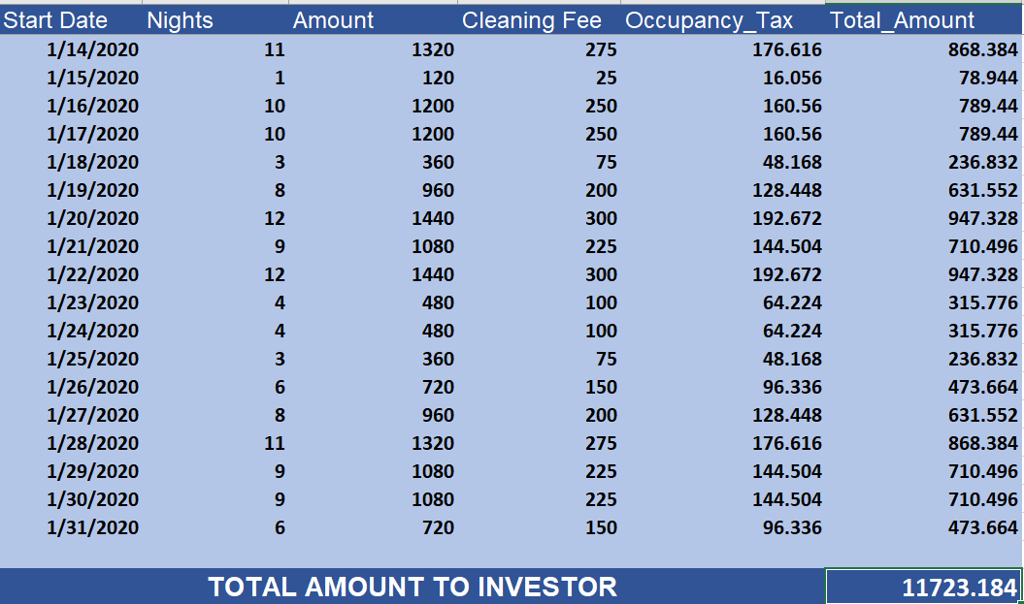
INVESTOR REPORT

Slide 8
For Part 2:
Different information related to owners , their units, location with maintenance and cleaning information was provided in an excel sheets
Performed data cleaning and data consolidation with respect to unit number.
Most of the revenue is generated between august to december and sales were at peak
Owner LeMar Koethe owned maximum number of units which includes entire MGM property and 1 Studio in Palms Villa.
Unit Number 53305 required the most cleaning and the cleaning expense was approximately $45,000 and least cleaning expense was required by Unit Number 56304
Owner Goettsche contributed the most for the room cleaning.
Unit Number 25321 required the most maintenance with a total maintenance cost of $1290.

Slide 9
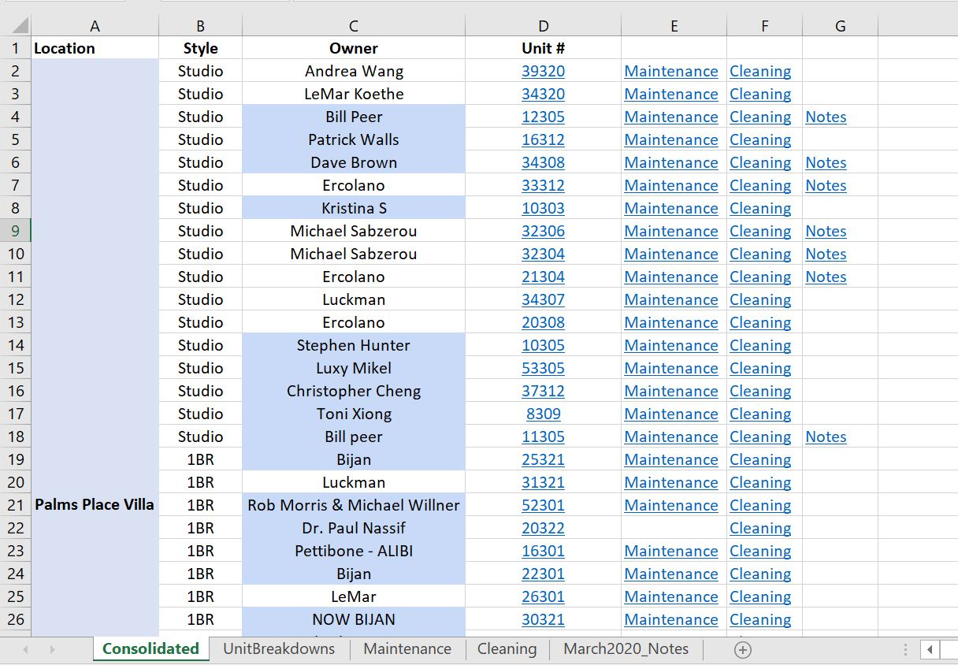
CONSOLIDATED REPORT

Slide 10
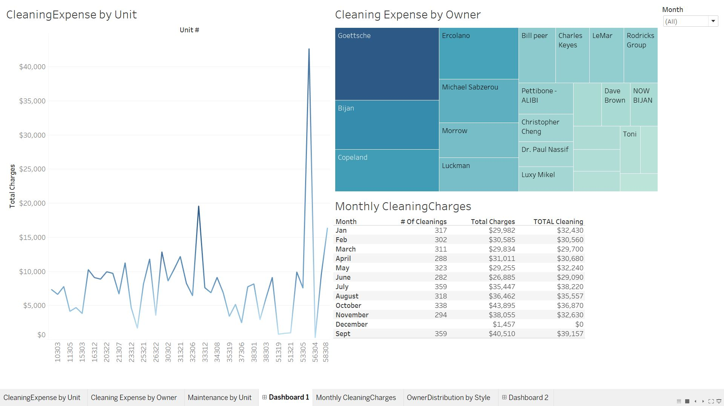
VISUALIZATIONS

Slide 11
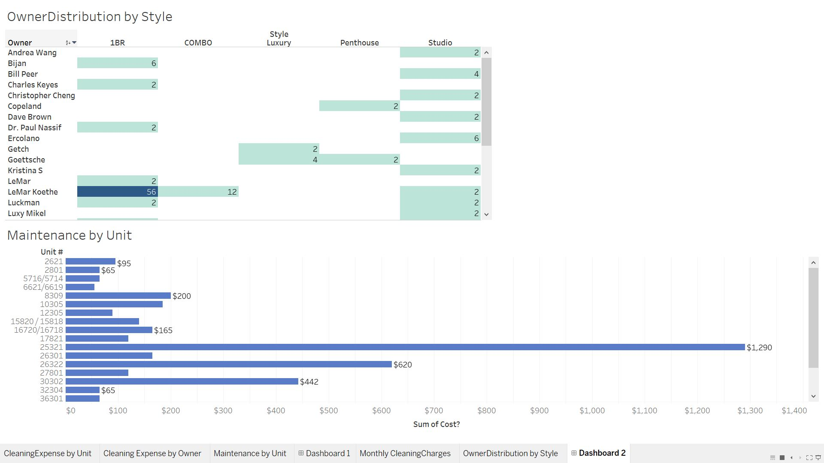

Slide 12
For Part 3:
Different approaches identified to reach potential customers for Marketing the place were
Social Media It is a very wide reaching tool that can target a large number of companies at the same time. A lot of options are available in this area. Some of them are Facebook, Instagram and Snapchat etc.
Create youtube videos It can be a good idea to create nice videos of rental places and post them on Youtube. It will help by giving a better idea of the place instead of simply posting pictures
Blogging Each individual owner can create blogs depicting the facilities and other details about their places.
Using Search Engine Optimization It can be a good idea to use SEO techniques to bring properties to appear higher on the search list. This can help get more clients and more revenue for the investors.
Hiring influencers Sometimes hiring social media influencers can be very much a positive change on the image of the property. They can create publicity and get attention towards the rental place.

Slide 13
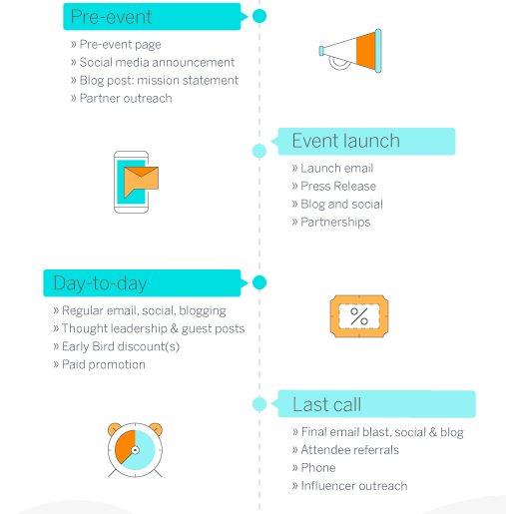
STRATEGY

Slide 14
LESSONS LEARNED
DEVELOPER:
Learned how excel macros work and how swiftly reporting can be done using the same
Learned to automate tasks by writing excel VBA scripts
Learned how to report bugs or failures during the implementation phase and over come the impediments or changes after the review.
Moreover learned about developer roles and responsibilities in a team project and how an agile team works
BUSINESS ANALYST:
Learned how planning, communication, elicitation, requirements validation plays a vital role
Learned how convenient it is to respond to a change in agile
Outlining a plan on how to transform data into fruitful information
Helping with quality checks for the products

Slide 15
LESSONS LEARNED
Scrum Master
Managing scrum teams, scheduling meetings and tracking progress
Ensuring a communication plan and managing flow of information in a timely manner
Removing roadblocks by constant communication with stakeholders
Devising marketing strategy
Product Owner
Owner of the product.
Created product backlog for the development team
Responsible for acceptance criteria for user stories
Performed UAT

Slide 16
DEMO OF SOLUTION

